Slide 1

SHREE RAMSWAROOP MEMORIAL UNIVERSITY
Assignment:-10
Java Enterprise Edition Lab - 10
Submitted to:
Submitted by:
Vidushi Srivastava
Mukesh Prajapati
Btech (Cse Industry integrated)
Roll No – 202410101230007

Slide 2
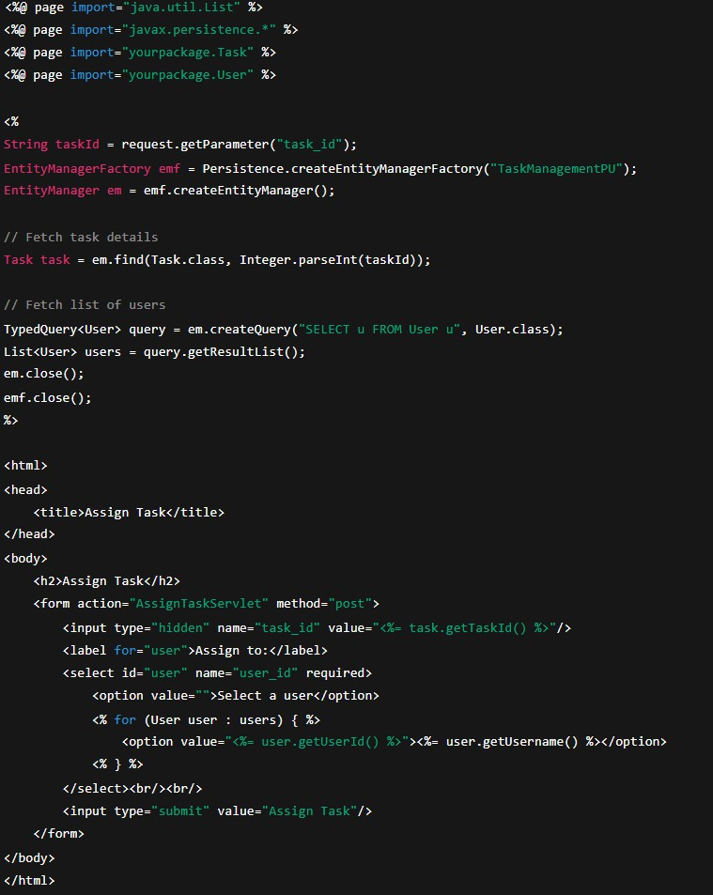
1⬛ Task Assignment Form (JSP Page)
This JSP form allows selecting a user and assigning a task.

Slide 3
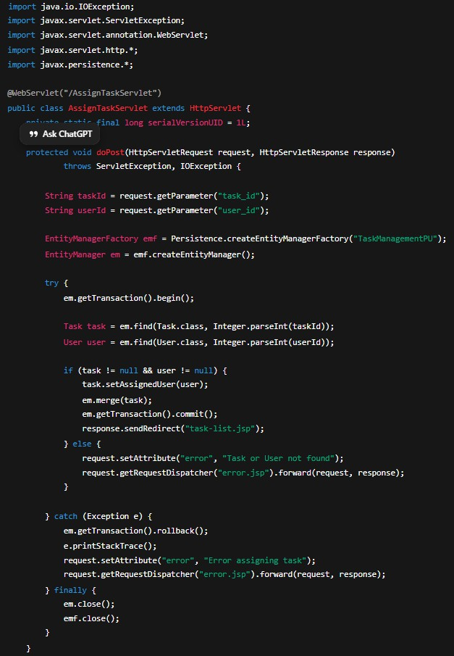
³⬛ Task Assignment Servlet
Handles the POST request, updates the assigned user in the database.

Slide 4
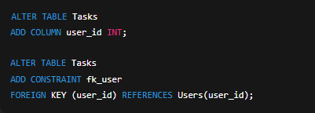
³⬛ Database Schema Update
Add a foreign key to link tasks with users.

Slide 5
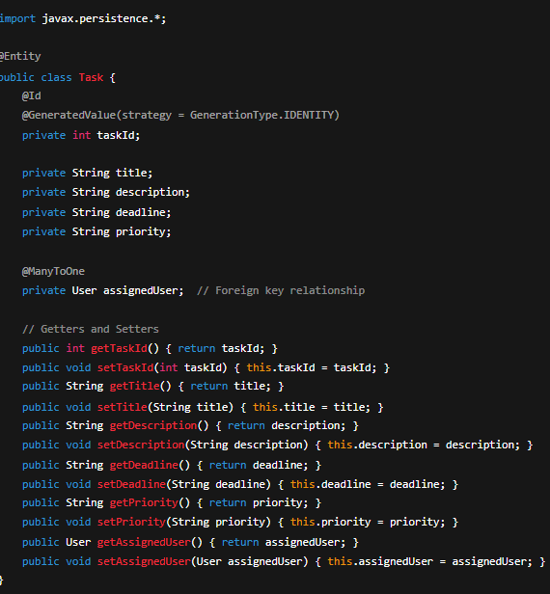
⬛G Updated JPA Entity (Task.java)

